Slide 1
Circuit Guard-PCB Defect Detection and Classification Application
LAVANYA R

Slide 2
INTRODUCTION
Printed Circuit Boards (PCBs) are essential components in all electronic devices, and detecting defects in them is critical for quality and reliability. Manual inspection is slow and error-prone, so this project develops an AI-based automated PCB defect detection system using image processing and deep learning. By comparing template and test images, extracting defect regions, and classifying them using an Efficient Net model, the system accurately identifies six major PCB defects. A Stream lit web application provides an easy-to-use interface for real-time analysis, making the solution practical for automated industrial inspection.

Slide 3
DATASET DEATILS
Dataset used: DeepPCB Dataset containing aligned template and test images.
Total Classes: 6 Defect Categories
  Missing Hole
  Mouse Bite
  Open Circuit
  Short
  Spur
  Spurious Copper
Dataset contains:
  1.Template images
  2.Rotated test images
  3.Annotation files
Images were preprocessed, aligned, and used to extract ROI samples.

Slide 4
MODULE 01 & 02 SUMMARY
Module 01 – Image Preprocessing
Performed template–test image alignment.
Applied image subtraction, Otsu thresholding & morphological filtering.
Generated binary masks highlighting potential defect areas.
Module 02 – ROI Extraction
Used contour detection to extract Region of Interests (ROIs).
Cropped defect patches for training dataset.
Verified bounding boxes visually.

Slide 5
MODULE 03 & 04 SUMMARY
Module 03 – Model Training
Trained EfficientNet-B0 classifier on extracted ROIs.
CPU-optimized training pipeline developed.
Saved model checkpoints and training logs.
Module 04 – Evaluation Metrics
Performed inference on validation images.
Generated confusion matrix, precision, recall, and F1-scores.
Saved annotated images and all evaluation outputs.

Slide 6
MODULE 05 & 06 SUMMARY
Module 05 – Streamlit Web App
Built an interactive web application.
Users can upload template & test images.
The app performs inference and displays defect locations with labels.
Supports CSV export of predictions.
Module 06 – Backend Pipeline Integration
Developed complete automation pipeline in module06_backend.py.
Pipeline performs preprocessing → ROI extraction → Classification → Annotation.
Supports single and batch inference.

Slide 7
MODULE 07 SUMMARY
Module 07 – Final Evaluation & Reporting
Performed large-scale batch evaluation.
Exported:
  Summary reports
  Confusion matrix
  Per-class performance metrics
Created final model trace for deployment.

Slide 8
STREAMLIT APP DETAILS
Built using Streamlit for easy deployment and clean UI.
Features:
  Upload template & test images
  Automatic preprocessing and defect detection
  Annotated images displayed live
  Downloadable CSV logs
Provides a user-friendly interface for non-technical users.

Slide 9
BACKEND OVERVIEW
Backend implemented in module06_backend.py.
Workflow pipeline:
  Load model checkpoint
  Preprocess inputs (resize, subtract, threshold)
  Extract defect ROIs using contours
  Predict defect class using EfficientNet-B0
  Draw bounding boxes & labels
  Save annotated image and CSV output
Designed for:
  Single image analysis
  Folder-level batch processing
  High-speed inference

Slide 10
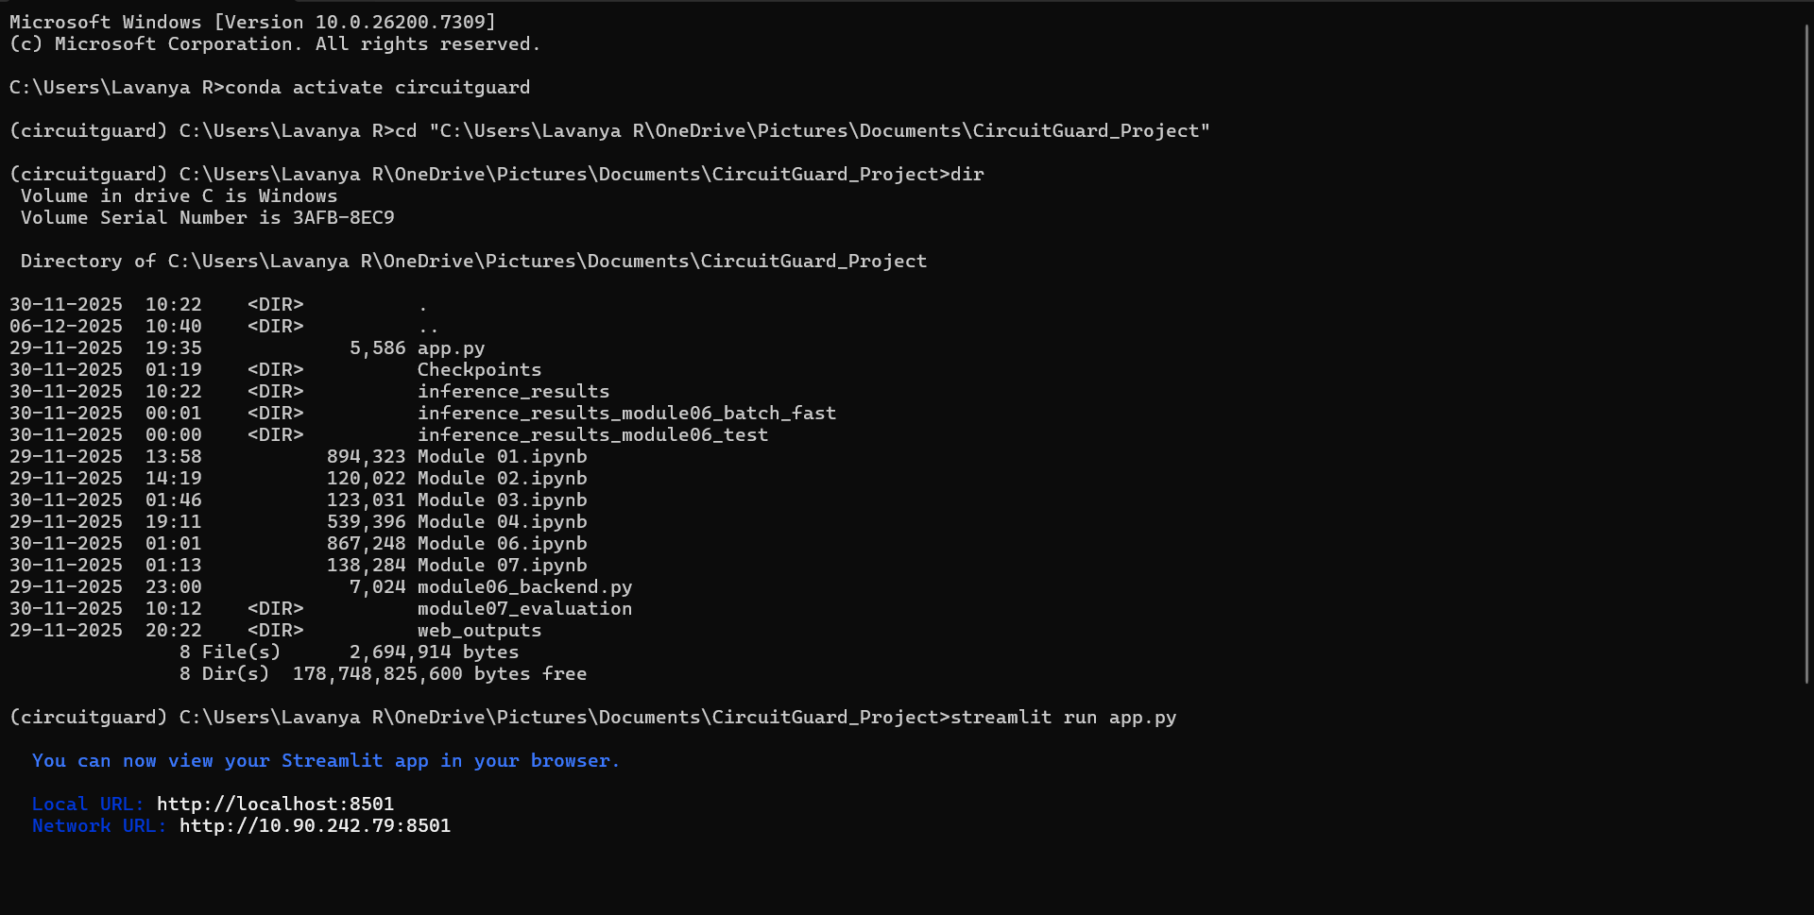
RESULTS

Slide 11
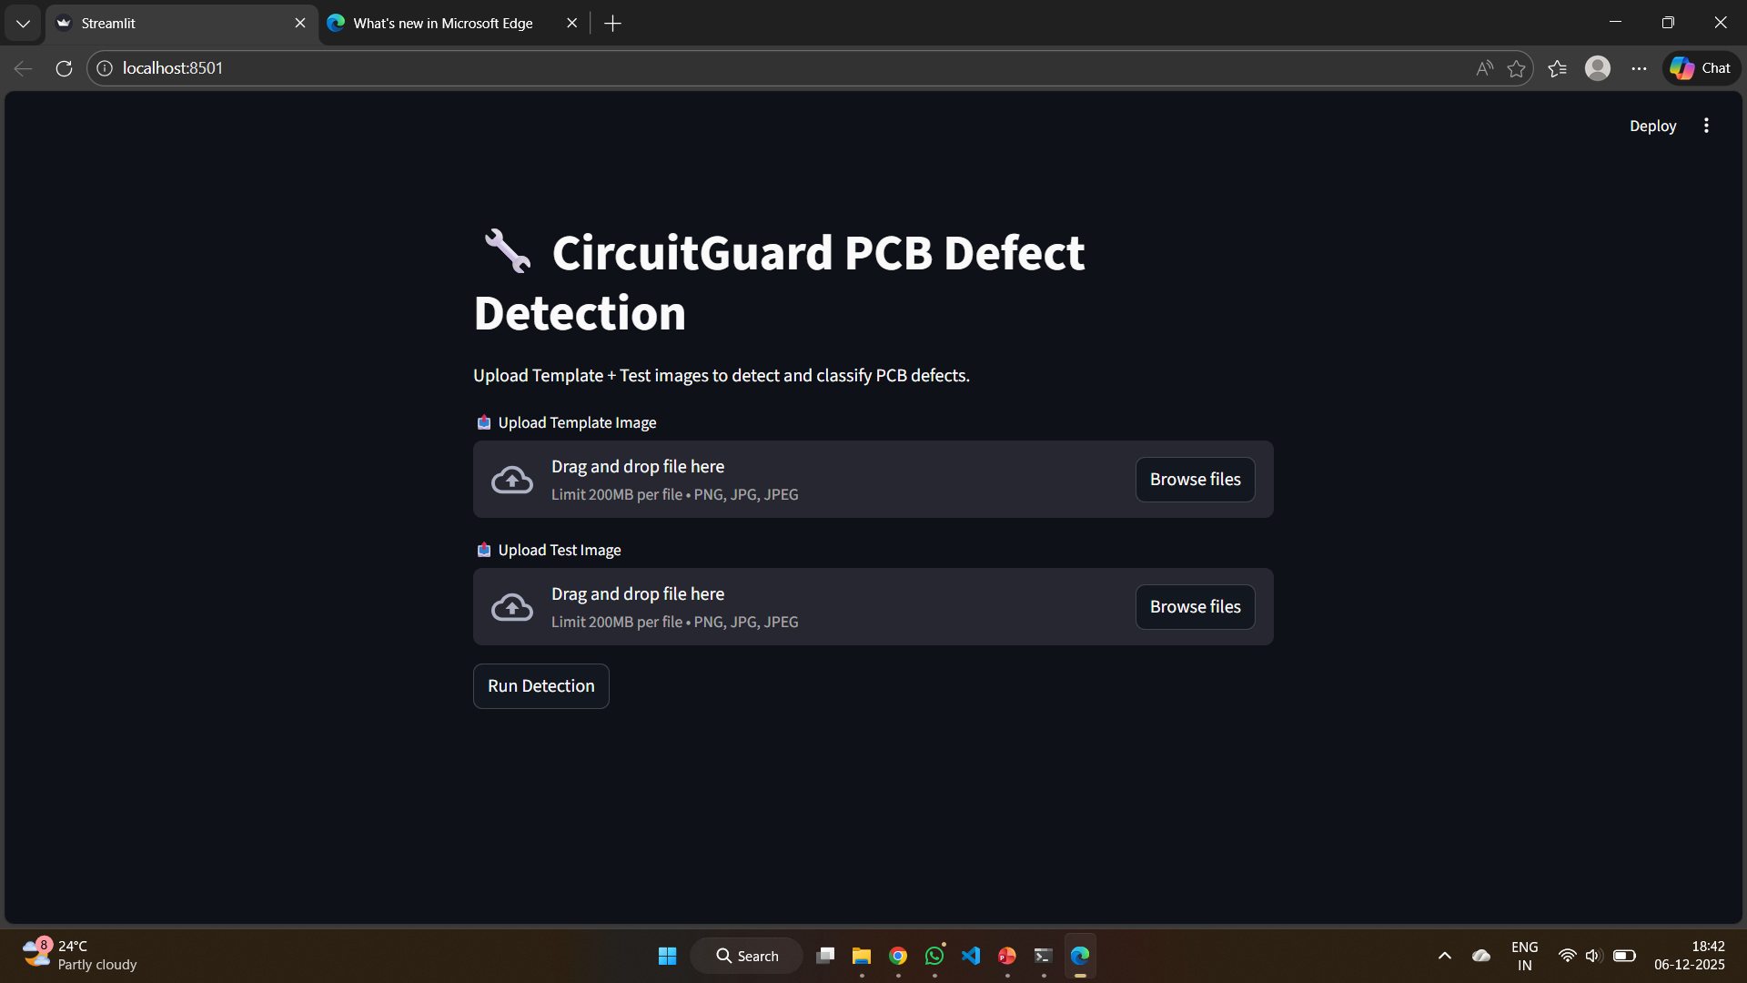
RESULTS

Slide 12
CONCLUSION
Successfully built an AI-powered defect detection system for PCBs.
Integrated image processing + deep learning + web interface.
End-to-end usability via Streamlit.
System can be improved with:
  GPU training
  Larger dataset
  More advanced models
Provides a strong foundation for real-time industrial PCB inspection.

